Slide 1
Data analysis Presentation
Cyclistic Bike-share
08/2024-07/2025

Slide 2
Agenda
01
Project overview
Slide 3
02
Data Table
Slide 4
03
Data analysis graphs/charts
Slide 5-7
04
Recommendations
Slide 8
05
Actionable steps
Slide 9
06
Thank you
Slide 10
Confidential

Slide 3
The purpose of this presentation is to analyze Cyclistic’s bike-share data to uncover differences between casual riders and annual members, highlight patterns in ride behavior, and provide actionable recommendations that can help the company increase annual memberships and long-term customer engagement.
PROJECT OVERVIEW
Confidential
Notes:
State my Business task: analyze how annual members and casual riders use Cyclistic bikes and identify any opportunities to convert casual riders to annual members.

Slide 4
Month | Average ride length casual | Average ride length member | Casual rides | Member rides | Mean ride length | Total rides
Jul-25 | 0:24:20 | 0:13:21 | 323337 | 440095 | 0:18:00 | 763432
Jun-25 | 0:25:34 | 0:12:57 | 292093 | 386811 | 0:18:23 | 678904
May-25 | 0:23:50 | 0:12:07 | 182637 | 319819 | 0:16:23 | 502456
Apr-25 | 0:21:30 | 0:11:20 | 109216 | 262125 | 0:14:19 | 371341
Mar-25 | 0:20:51 | 0:11:16 | 85869 | 212286 | 0:14:02 | 298155
Feb-25 | 0:14:24 | 0:10:00 | 27754 | 124126 | 0:10:48 | 151880
Jan-25 | 0:14:43 | 0:10:04 | 24153 | 114536 | 0:10:53 | 138689
Dec-24 | 0:17:45 | 0:10:46 | 38376 | 139996 | 0:12:16 | 178372
Nov-24 | 0:19:29 | 0:11:07 | 93078 | 241997 | 0:13:26 | 335075
Oct-24 | 0:23:14 | 0:11:59 | 216446 | 399835 | 0:15:56 | 616281
Sep-24 | 0:21:38 | 0:12:13 | 346804 | 474472 | 0:16:11 | 821276
Aug-24 | 0:26:04 | 0:13:25 | 318280 | 437359 | 0:18:45 | 755639
Confidential
Notes:
This is the sum of all the data i took in one clean chart. Average ride length is based on all the rides from that specific month. Total rides is the total amount of every trip with our bikes each month.

Slide 5
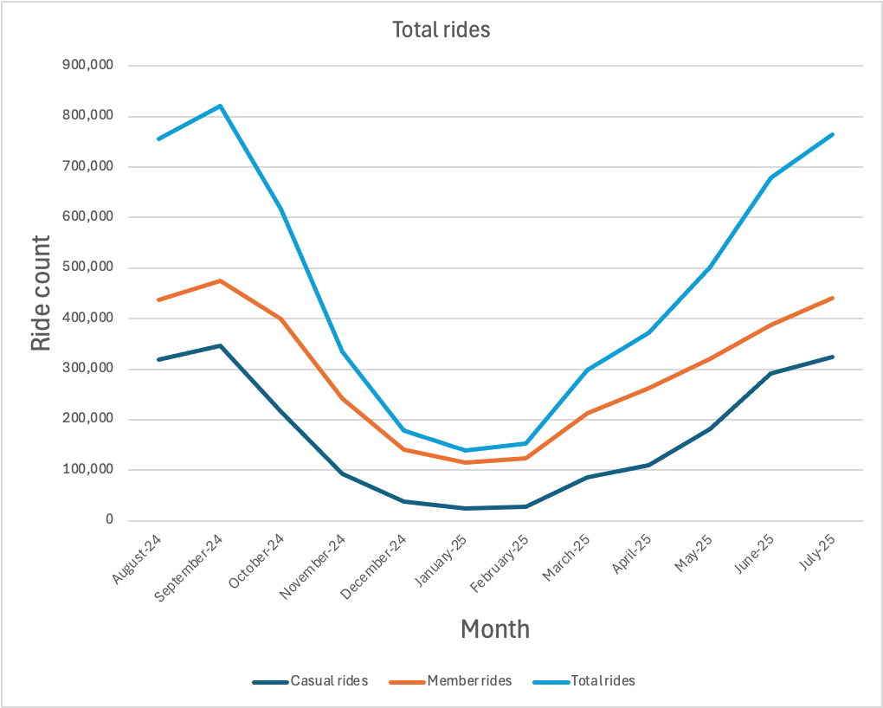
Analysis of total rides
This graph shows the total ride count, the casual ride count, and the member ride count.
Notes:
As we can see in this graph, the total number of rides decreases when we get to the winter months. We also notice casual riders take a significant dip in rides during the winter months.

Slide 6
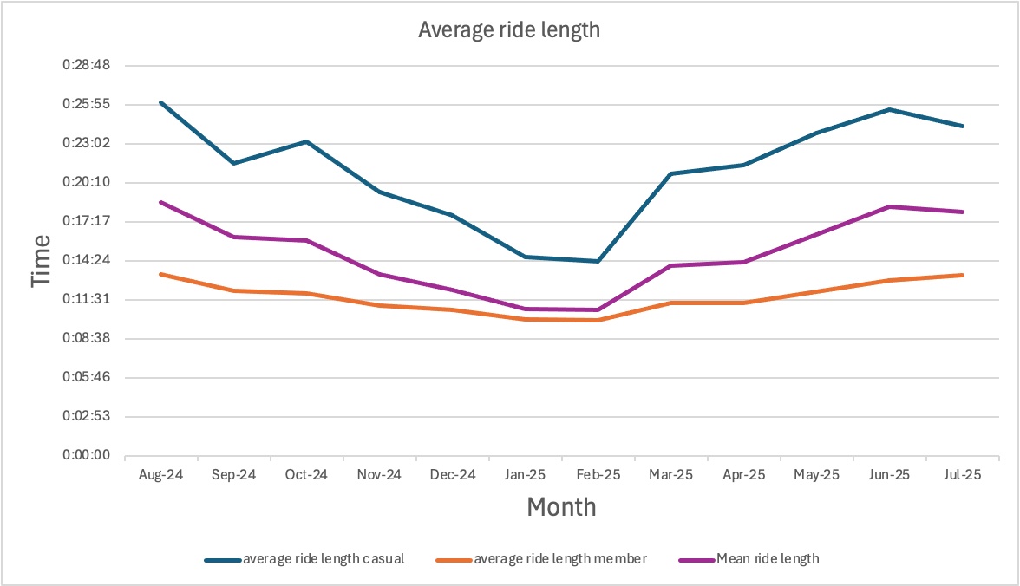
Analysis of Ride length
Shows the difference in ride length between casual and member rides throughout each month.
Confidential
Notes:
From the graph, we can see that casual rides last much longer than member rides. I wonder if there is a reason for this. This brings me to my next slide

Slide 7
Most common day of the week
Month | Most common day Casual | Most common day Member
Jul-25 | Saturday | Tuesday
Jun-25 | Saturday | Monday
May-25 | Saturday | Thursday
Apr-25 | Saturday | Tuesday
Mar-25 | Saturday | Monday
Feb-25 | Friday | Tuesday
Jan-25 | Thursday | Thursday
Dec-24 | Monday | Monday
Nov-24 | Saturday | Friday
Oct-24 | Saturday | Wednesday
Sep-24 | Sunday | Monday
Aug-24 | Friday | Wednesday
From this table, we can start to get an explanation as to why casual rides are longer than member rides.
Confidential
Notes:
It seems like casual riders are using the bikes on weekends while member riders are using the bikes on weekdays. We can infer that members are using the bikes for commuting purposes.

Slide 8
What can we do next?
Objective 1
Create a weekend focused membership promotion.
Objective 2
Highlight year-round commuting benefits.
Objective 3
Target casual riders with personalized in-app nudges
Confidential

Slide 9
How to achieve these goals
Objective 1
Design a weekend rider membership campaign. In the membership details we can explain how much money casual riders can save if they become annual members. For example: we tell them “you will save X amount of dollars per month if you ride every weekend.” This could help to entice the casual riders to purchase annual memberships.
Objective 2
Let’s market our bike companies annual membership as a way to show that biking can be a reliable commuting option year-round. To get people using bikes in the winter, let's offer winter perks for annual riders (for example: discounts on winter apparel/gear and guaranteeing bike availability). This will help show that our memberships have a consistent value beyond just summer fun.
Objective 3
After a casual rider has rode a couple weekends in a row, our app can send a notification that encourages them to buy the annual membership. It can say something like, “great job logging X amount of rides, a membership could have saved you $X amount of dollars. Ready to upgrade?”
Confidential
Notes:
This could help to entice the casual riders to purchase annual memberships.
This will help show that our memberships have a consistent value beyond just summer fun.
This can give the rider an immediate and personal value to our membership.

Slide 10
Thank you!
Any Questions/comments?
Confidential

